Slide 1
Security training and immunization
Payam Khaninejad
http://khaninejad.ir

Slide 2

Email & Internet Scams

Slide 3
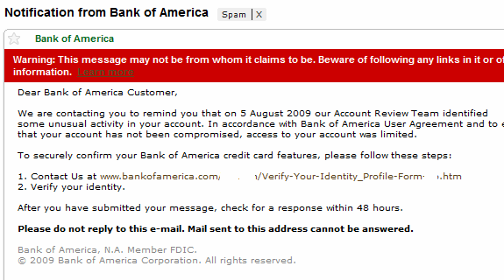
The Bank

Slide 4
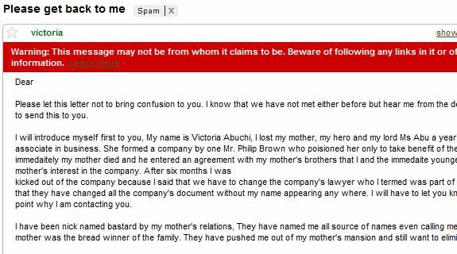
Nigerian Inheritance

Slide 5
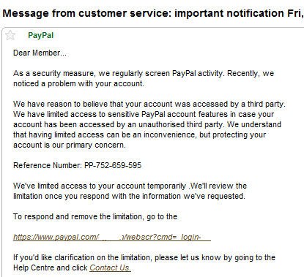
Phishing Email Scam

Slide 6
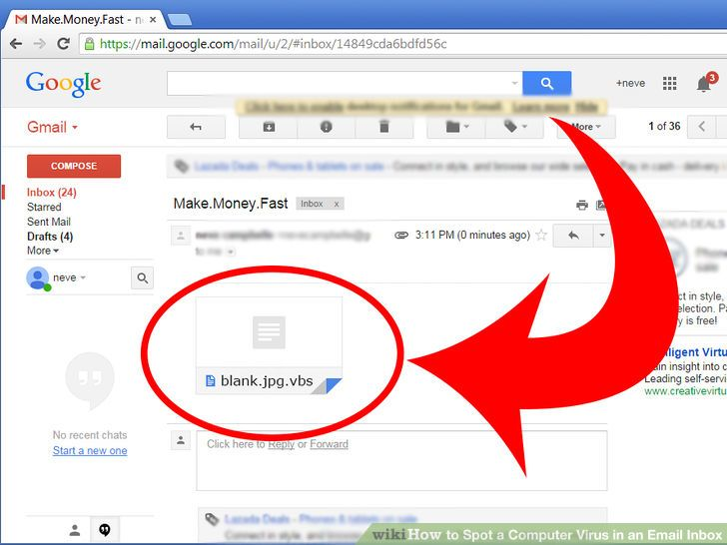
Virus E-Mails

Slide 7
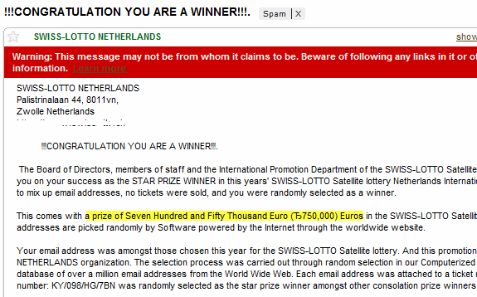
Lottery Email Scams

Slide 8
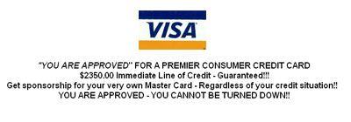
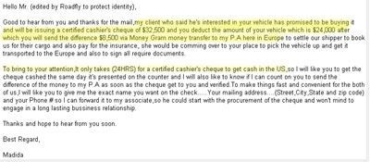
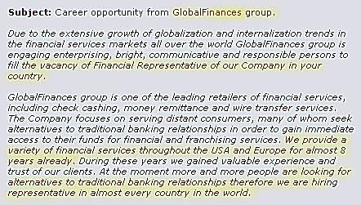

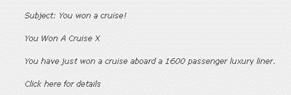
And more
Advanced fees paid for a guaranteed loan or credit card
Items for sale overpayment scam
Employment search overpayment scam
Disaster relief scams
Travel scams
“Make Money Fast” chain emails
"Turn Your Computer Into a Money-Making Machine!"

Slide 9
How to avoid Common Scams Online
The Sender Is a Person
Your Name Is Not in the “To” Field
The Lottery Doesn’t Exist
Request for Information
The Sender’s Email Address Is Suspicious
They Don’t Know Who You Are
The Linked URL Is Not Legitimate
The Email Includes a Threat
You Have to Pay Upfront.
You Receive a Fraudulent Check
Delete Unsolicited Emails
Don’t Believe Promises of Money or Prizes
Question Requests for Donations
Never Disclose Sensitive Personal Information
Hover Before You Click

Slide 10

Social Engineering Attacks

Slide 11
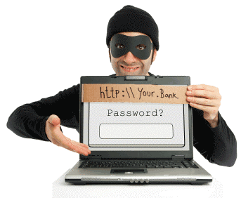
Phishing

Slide 12
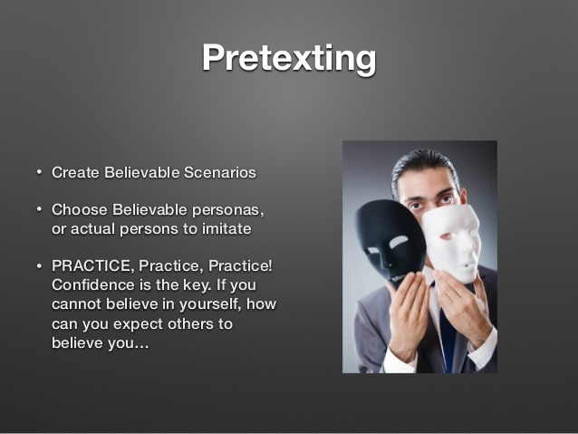

Pretexting

Slide 13

Baiting

Slide 14


Quid Pro Quo

Slide 15
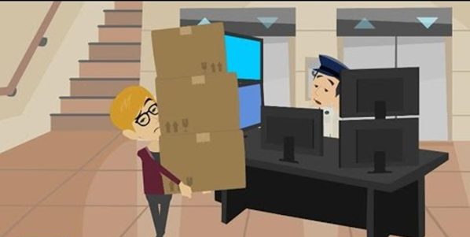

Tailgating

Slide 16
Recommendations
Do not open any emails from untrusted sources
Do not give offers from strangers the benefit of the doubt
Lock your laptop
Purchase anti-virus software
Read your company’s privacy policy

Slide 17
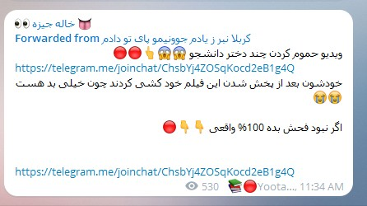
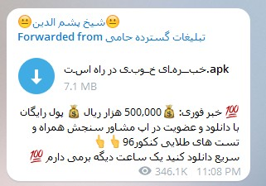
Telegram

Slide 18
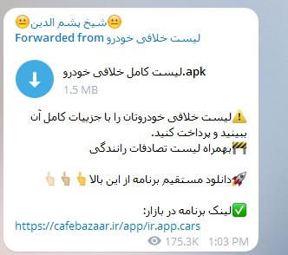
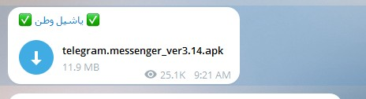
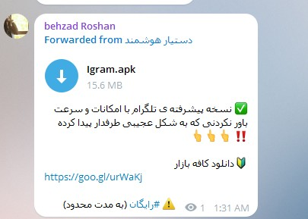
Telegram

Slide 19
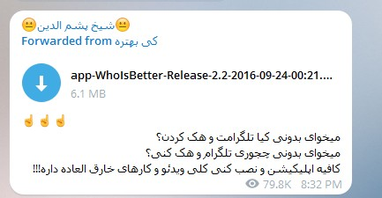

Telegram

Slide 20
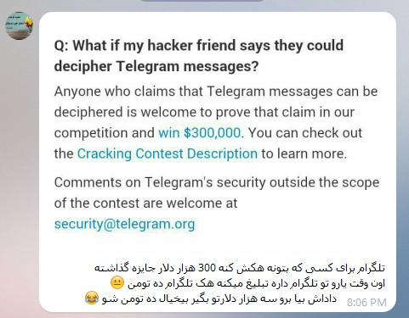
Telegram

Slide 21
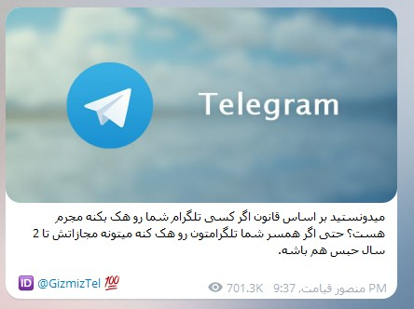
Telegram

Slide 22
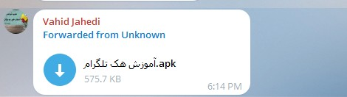
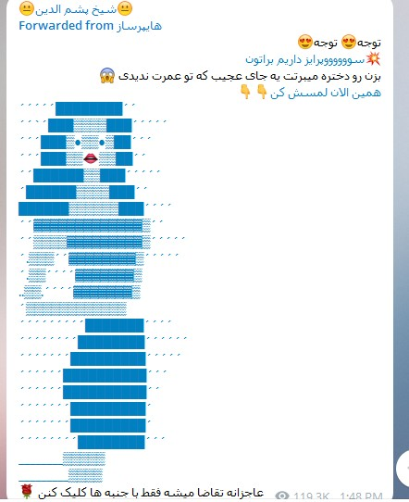
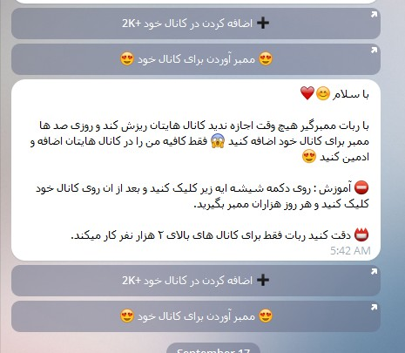
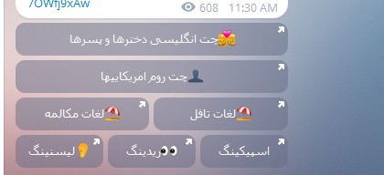
Telegram

Slide 23
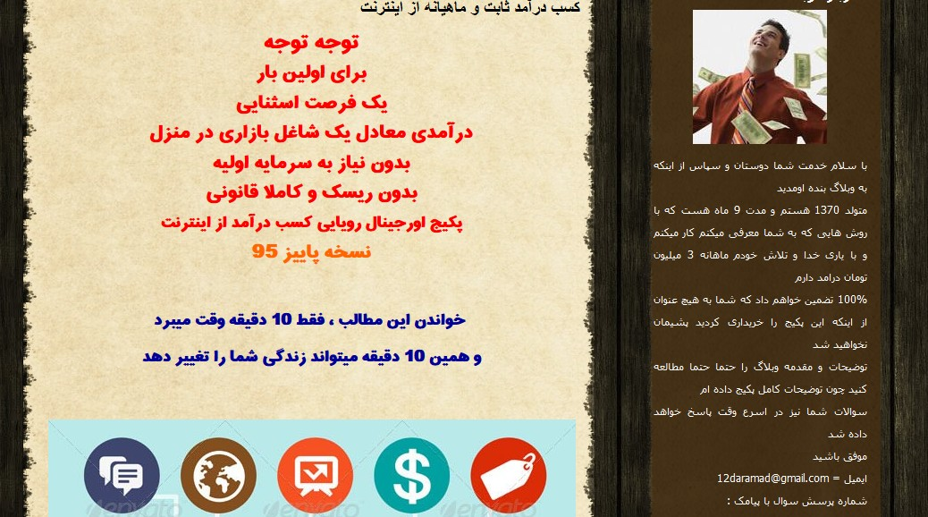
Money Manking

Slide 24
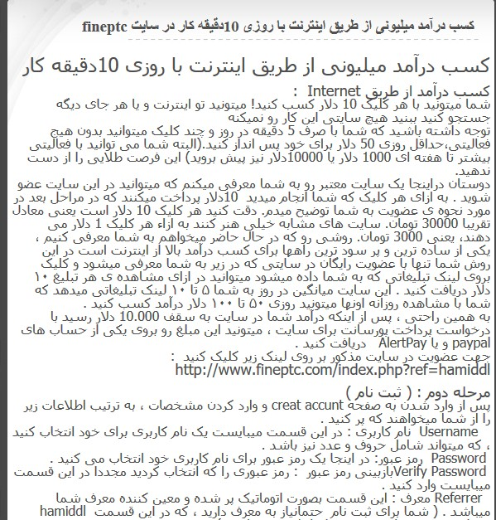
Money Making

Slide 25
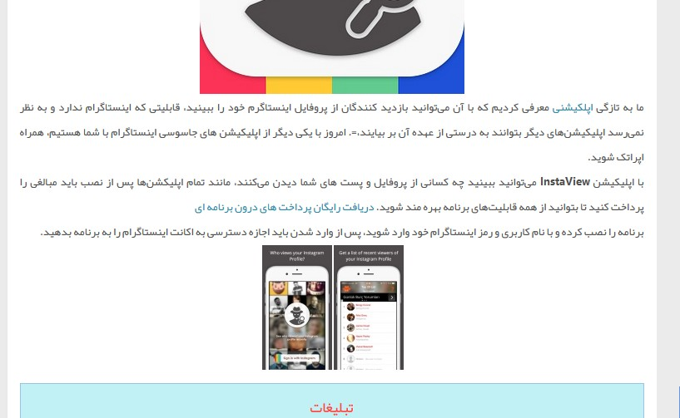
Instagram

Slide 26
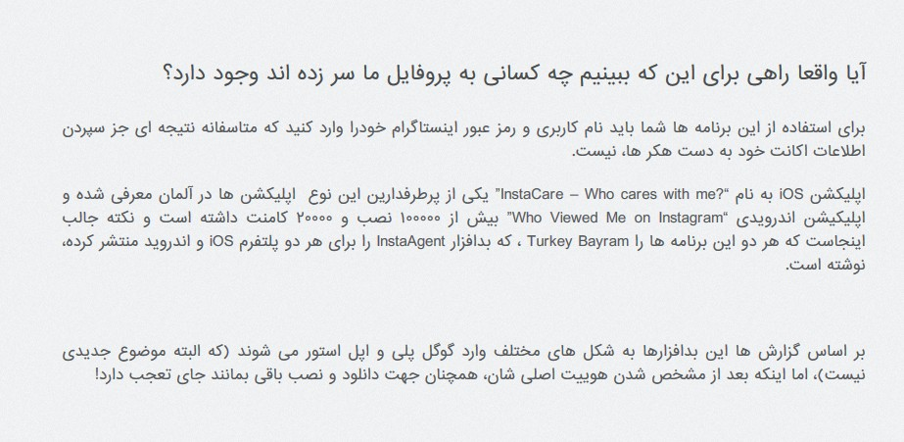
Instagram

